Slide 1
Sivakavindiran D
au412721205046
3/21/2024 Annual Review

Slide 2
PROJECT TITLE
Self Driving Car
3/21/2024 Annual Review

Slide 3


AGENDA
Review recent advancements and challenges.
Discuss hardware and software developments.
Review safety protocols and reliability testing.
Updates on regulations and compliance efforts.
Identify priorities and assign action items.
Address any additional topics or concerns.
3/21/2024 Annual Review

Slide 4

PROBLEM STATEMENT
Developing a self-driving car that can navigate safely and efficiently in diverse real-world environments, while addressing technical challenges such as perception, decision-making, and regulatory compliance.
3/21/2024 Annual Review

Slide 5

PROJECT OVERVIEW
The project aims to develop an autonomous vehicle capable of navigating through varied real-world scenarios safely and efficiently. Leveraging advanced sensor technology, machine learning algorithms, and robust software systems, the self-driving car will perceive its environment, make real-time decisions, and execute maneuvers autonomously.
3/21/2024 Annual Review

Slide 6

WHO ARE THE END USERS?
Individual Consumers
Commercial Businesses
Public Transportation Services
Elderly and Disabled Individuals
Tourism Industry
Government Agencies
3/21/2024 Annual Review

Slide 7
YOUR SOLUTION AND ITS VALUE PROPOSITION
Our self-driving car is equipped with advanced sensor technology, including LiDAR, cameras, and radar, to perceive its environment with exceptional accuracy.The autonomous nature of our self-driving car eliminates the need for manual driving, allowing passengers to relax, work, or engage in leisure activities during their commute.Our self-driving car solution enhances mobility options for individuals with limited mobility, including the elderly and disabled.Over time, our self-driving car solution offers significant cost savings compared to traditional human-driven vehicles.
3/21/2024 Annual Review

Slide 8

THE WOW IN YOUR SOLUTION
Unmatched Safety: Cutting-edge sensors and AI ensure unparalleled safety, surpassing human drivers.
Ultimate Convenience: Transform your commute into productive, relaxing, or entertaining time, freeing you from the hassle of driving.
Efficiency Redefined: Real-time route optimization minimizes travel time, fuel consumption, and emissions.
Inclusive Accessibility: Empowering everyone to travel independently, regardless of age or ability.
Sustainable Future: Leading the way to a cleaner, greener transportation system with electric and shared autonomous vehicles.
3/21/2024 Annual Review

Slide 9
MODELLING
Modeling for self-driving cars involves creating sophisticated algorithms and systems to handle perception (interpreting sensor data), decision-making (planning routes, predicting behaviors), and control (managing steering, acceleration). Simulation is crucial for testing in virtual environments. Machine learning enhances capabilities, and human-machine interaction design ensures intuitive interfaces. These elements combine to develop safe, efficient, and user-friendly autonomous vehicles.
3/21/2024 Annual Review

Slide 10
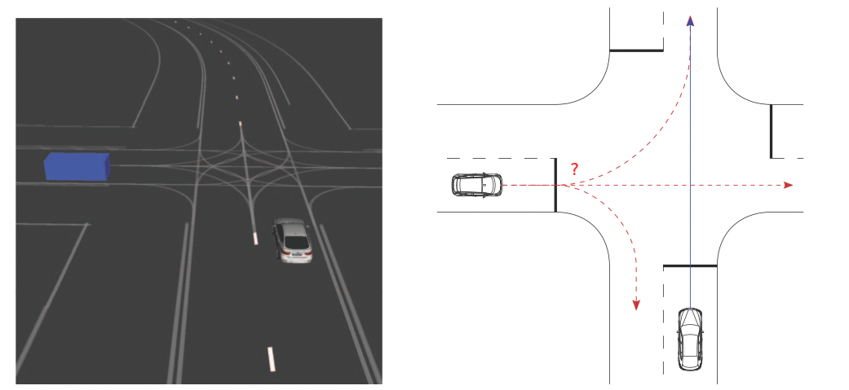
RESULTS
Demo Link
3/21/2024 Annual Review

